Slide 1
TIME MANAGEMENT
Being successful doesn’t make you manage your time well. Managing your time well makes you successful.

Slide 2
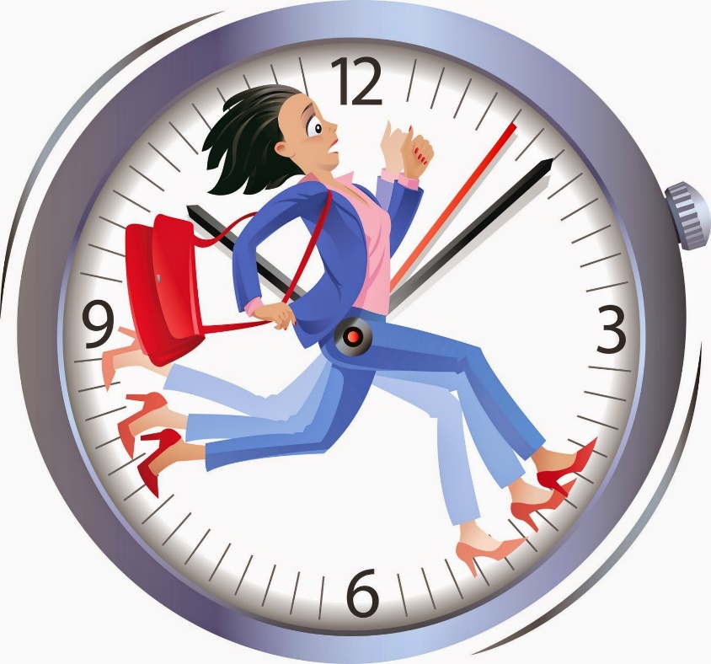
Benefits of Time Management
The ability to manage your time effectively is important. Good time management leads to improved efficiency and productivity, less stress, and more success in life.
This Photo by Unknown Author is licensed under CC BY-SA

Slide 3
Time Wasting
People waste about 2 hours per day.
Signs of time wasting:
Can’t find things.
Messy desk, clutter, disorganized.
Missed appointments, need to reschedule them or unprepared for meetings.
Volunteer to do things other people should do.
Tired/unable to concentrate
Distractions (seen and unseen) that are eating up your time.

Slide 4
What Causes Stress
What causes stress?
Internal sources
External sources
WHAT IS STRESSFUL FOR YOU?

Slide 5
Effects of Stress
Cognitive Symptoms
Memory problems
Inability to concentrate
Poor judgment
Seeing only the negative
Anxious or racing thoughts
Constant worrying

Slide 6
Emotional Symptoms
Moodiness
Irritability or short temper
Agitation or inability to relax
Feeling overwhelmed
Sense of loneliness and isolation
Depression or general unhappiness
Physical Symptoms
Aches and pains
Diarrhea or constipation
Nausea and or dizziness
Chest pain and or rapid heartbeat
Frequent colds

Slide 7
Physical symptoms continued
Eating more or less
Sleeping too much or too little
Isolating yourself from others
Procrastinating or neglecting responsibilities
Using alcohol, cigarettes, or drugs to relax
Nervous habits (e.g., nail biting, pacing)

Slide 8
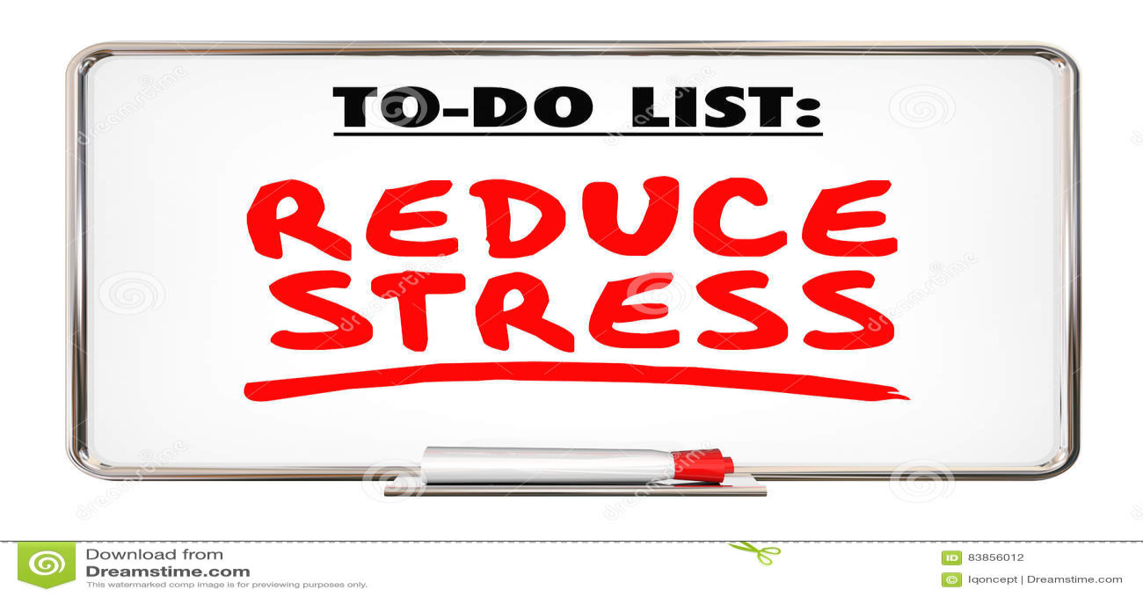
Stress Reduction
Reduce your stress through:
Time management
Organization
Delegation

Slide 9
Time Management works when:
YOU CAN
Identify problems and set goals.
Prioritize wisely.
Organize yourself and develop solutions.
Agree and commit to change.
Plan ahead.
Arrange support within the team and from managers.

Slide 10
What can stop you?
Negative thoughts
Negative people
Low self-esteem
Fear of failure
Fear of rejection
Fear of criticism

Slide 11
Goals, Priorities and Planning
Why am I doing this?
What is the goal?
Why will I succeed?
What happens if I choose not to do it?
Planning: Failing to plan is planning to fail.
Plan each day, each week, each month.
You can always change your plan, but only once you have one!

Slide 12
Organizing: The to-do list
Helps you prioritize
Helps you overcome procrastination
It’s a critical starting point – not a stand-alone tool.
Break things down into small steps
Do the worst thing first.

Slide 13
Optimize your work environment
Get rid of clutter.
Reduce noise issues with headphones or music.
Bring a bit of nature into your workspace.
Set up your tools for focus.
Make your space comfortable for you.

Slide 14
PRIORITIZING A B C
Write a to-do list.
Break large tasks into smaller tasks.
Delegate those tasks more suitable for another coworker.
Schedule your day/week. Assign deadlines.
Consider when your peak time is to focus and be engaged and plan your most demanding tasks in this time bracket.

Slide 15
Steve Jobs wrote: “It’s pretty clear that time is the most precious resource we have.”
With only limited time to do our most meaningful work, it’s natural to feel a certain level of anxiety. But time management isn’t about quelling the fear of wasting time. It’s about understanding the far reaching benefits of using our time wisely.

Slide 16
Proper Time Management you:
Feel more in control of your day and less likely to be stressed, overwhelmed or burned out.
Become more productive at work and able to disconnect at the end of the day, leading to a better work-life balance.
Are able to stay focused for longer and see positive return on time spent well.
More awareness of time spent on unproductive activities and can build better habits and routines.
Make more time for meaningful work and connect to a larger purpose.

Slide 17
A Priority Category
Urgent and important tasks.
Support a long term goal.
Support others you work with.
Ask? What would happen if I didn’t do this today?
Only top priorities get into A category

Slide 18
B Priority Category
Important tasks but not a priority.
Mild consequences for not doing this tasks.
Time can elevate to A or drops to C depending on waiting period.
Never do a B task when there is an A task that needs to be finished.

Slide 19
C Priority Category
Not urgent, not important.
No consequences for not doing this
Nice to do
Know the expectations and tasks for each job.
Especially if your task affects another coworker’s tasks. Don’t assume. Communicate.

Slide 20
BIG PICTURE
Have the big picture in sight at all times.
Know your schedule
Determine how long it takes you to complete various tasks.
Plan a balanced schedule which includes fixed tasks and flexible tasks that can be included in your day/week.
Identify odd hours and small amounts of time that you can use to complete tasks.
Take your breaks and lunch hour. It helps revitalize your brain and energy.
Keep your plan visible and accessible.

Slide 21
Paperwork
Keep desk organized, focus on one thing at a time. Clutter leads to thrashing which leads to lost time.
Have a good file system.
Touch each piece of paper once.
Touch each piece of email once, this is not your “to-do” list.

Slide 22
Overcoming Procrastination
Recognize how you procrastinate.
Evaluate reasons for doing this.
Take counter-measures against procrastination.
Use a to-do list.
Break large tasks into smaller parts.
Schedule specific times to do things you are most likely to put off.
Address reasons (e.g., don’t like to do, hard to start, fear of failure, lack of information, etc.)
Reward yourself for starting and finishing.
Create the right environment
Set up the task first. It’s OK that you can’t do
Post deadlines to guide you. everything perfectly.
Do the fun stuff first.
Start somewhere ----anywhere

Slide 23
Perfectionism
Do you tend to be a perfectionistic person?
Take a look at how you spend your time.
What is your self-talk, analyze and reframe it.
Big picture – focus on it, what needs to happen and when.
What really needs to happen now, today, tomorrow by Friday?
Maintain high and attainable standards.
Be realistic about what you can accomplish.
Don’t throw work away but how can you adjust it fit in an attainable framework.
Seek help when you need it or feel stuck.

Slide 24
Disruptions (ugh)
Disruptions are often urgent to the one presenting them but may not be so important to you.
Identify recurring interruptions and distractions. (keep a log)
Learn to say no. Be polite, professional, respectful and assertive.
Establish times that you are available/not available.
Set limits with necessary interruptions.
Develop phrases that deflect the “got a minute” intrusion to another time.
Used “modified” open door policy.
Consider working in other locations sometimes.

Slide 25
Configure your office so your desk faces the door.
Stand up on the entry of intrusive visitors.
Schedule meetings in other people’s office/space.
Telephone Tips
Keep calls short; stand during call.
Start by announcing goals for the call.
Don’t put your feet up.
Have something in view that you’re waiting to get to next.

Slide 26
Avoid taking on too much
Learn to set limits and say no “thank you.”
Learn to delegate, share work and let others help.
You don’t find time for important things, you make it.
Everything you do is an opportunity cost or benefit.
Find your dead time and schedule meetings, phone calls or other mundane stuff you need to do.
Use automatic systems when possible.
Get enough rest, eat well, exercise, destress regularly.
Ask for advice when you need to.

Slide 27
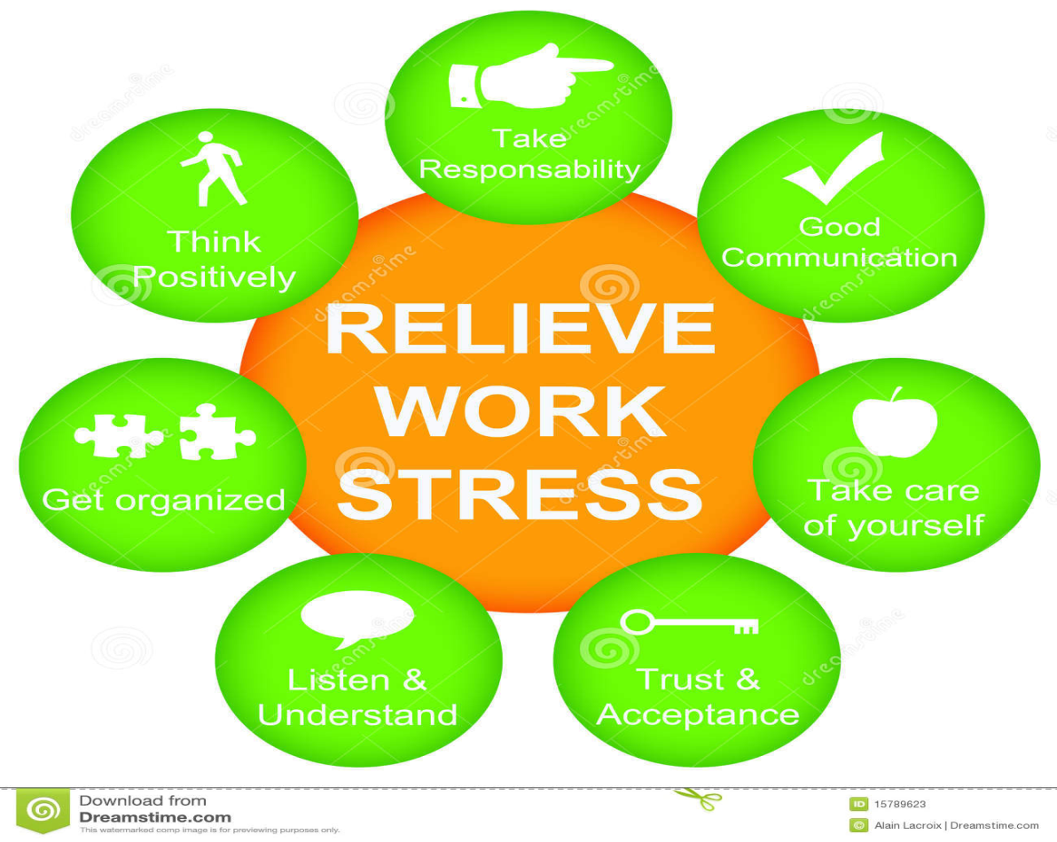
Make a Plan today
Plan your work then work your plan.
Managing your time increases your success.
Managing your time reduces your stress
Managing your time well enhances work-life balance.

Slide 28
THE END
This Photo by Unknown Author is licensed under CC BY

