Slide 1
Creating a Healthy Work Environment
It begins with YOU.

Slide 2
Teamwork is the ability to work together toward a common vision.
The ability to direct individual accomplishments toward organizational objectives.
It is the fuel that allows common people to attain uncommon results. -- Andrew Carnegie
Teamwork
working

Slide 3
“Lots of people want to ride with you in the limo, but what you want is someone who will take the bus with you when the limo breaks down. -- Oprah Winfrey

Slide 4
Team Building
Mission Purpose & Goals
Decision-making
Growth Continuous Improvement
Communication
Guidelines Accountability
Roles & Responsibilities

Slide 5
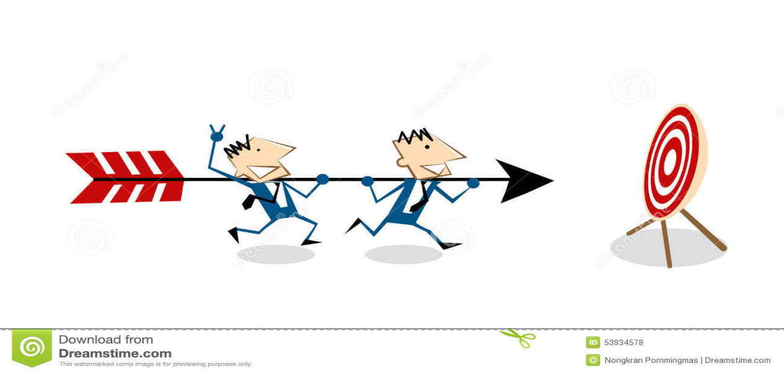
In a team oriented environment you contribute to the overall success of the organization. You work with fellow employee, management and diverse areas to produce results. You are unified with other teams to accomplish the overall objectives. You differentiate the overall sense of teamwork from the task of developing an effective intact team that is formed to accomplish specific goals.

Slide 6
Successful teams require the attention to each of the following:
Do you know what the expectations of the team are? (i.e.; performance and expected outcomes.
Do you understand the context of the team; Why are you participating on the team? Can you define the team’s importance in accomplishing their tasks and goals?
Are you committed and want to participate on the team?
Is there a high level of competence within the team that you feel you have the right people participating? (i.e.; do members have the knowledge and skill to do their jobs?)
Do team members clearly understand their boundaries? Is there enough freedom and empowerment to feel ownership of their tasks and accomplishments?

Slide 7
Does the team understand the team and group process? Are the team members working together effectively and understand each other’s roles and responsibilities?
Does the team approach problem solving processes to work toward better understanding and improvement?
Does the team have a clear understanding of their priorities?
Is there a method to give feedback and receive feedback?
Do they communicate clearly, honestly and respectful in their communication?
Are conflicts and differences addressed in a timely fashion?
Does the team feel responsible and accountable for their achievements?

Slide 8
There are several things you can do to make your work environment a positive one and to facilitate a feeling of cooperation, teamwork and joy among the team. TRUST
Trust is the basic tenant for all relationships. So building an environment of trust is one of the most important things you can do to create a positive work environment. It’s a philosophy that must be demonstrated in everything you and your team does.
Trust is about doing what you say you are going to do.
Trust is about being who you say you are.
Trust is being reliable, responsible and accountable, and being consistent in your words and actions.
Trust is about setting the same expectations for everyone on the team.

Slide 9
If your coworkers can see that you are consistent with your words you will build trust, but if they see your words don’t match your behaviors their trust will not be gained. Trust is fragile. It is important that you are aware of your words and behaviors and insure that they are worthy of your coworkers trust.
When dealing with uncomfortable situations, if you are honest and up front it will make things easier for everyone.
What you say and what you do represent who you are.
How well do you keep confidences and don’t disclose discussions or information that has been shared in private?
A good employee never talks negatively about another coworkers.

Slide 10
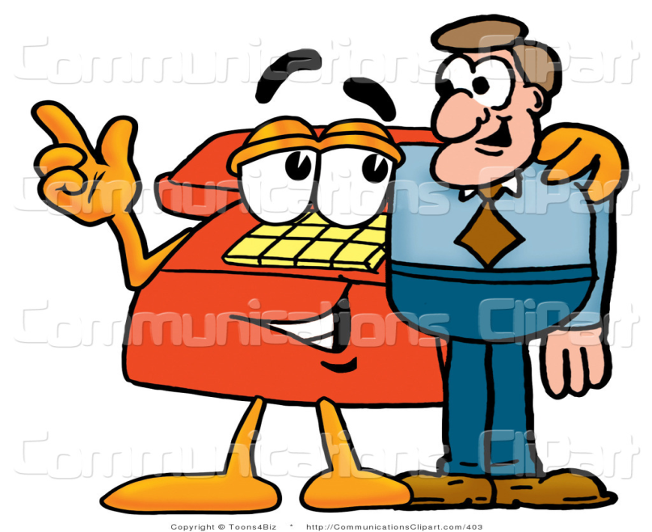
How Do You Communicate?
To create a positive work environment each employee needs to feel valued. If you offer active listening, listening to each person and honoring each person for what they bring to the team, they will feel their value. Respecting every individual in your environment will help create a strong team with good communication.

Slide 11
Another important aspect of communicating openly is to have discussions about mission, values and goals. It is important for each employee to model good work ethics and share what expectations have been set for the team. These discussions can help the team fulfill these standards about talking about ideas, thoughts and ways to be successful. It’s about:
Being accountable to the job.
Showing up on time.
Showing up with a positive attitude.
Willingly taking on tasks and assignments.
Being proud of your role, team and what you do.
Treating everyone with respect; in a friendly manner.
Focusing on work and leaving personal issues outside the workplace.
Seeing your work as an opportunity for continuous growth and learning.

Slide 12
Let go of your ego.
Be assertive and professional.
Take Pride in Your Work
Do you believe in the value of your work?
Do you believe in the value of yourself?
When you have a positive work ethic and excellent work skills:
You feel good about yourself
You have a sense of integrity and honor. You make choices that develop your character in a positive way.

Slide 13
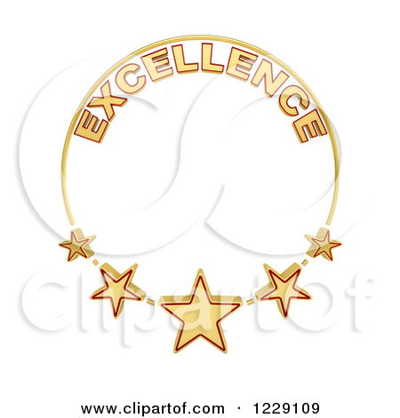
You feel more in control
As Stephen Covey writes in “7 Habits of Highly Effective People,” we have two ways to put ourselves in our lives immediately.
We can make a promise and keep it.
We can set a goal and achieve it. Developing work ethics and excellence afford you many opportunities to do both.

Slide 14
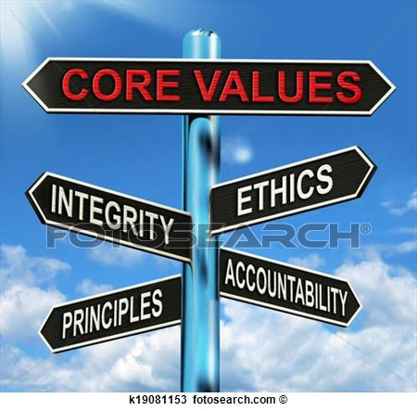
Focus on how well you perform your job.
What is your level of skills, knowledge and ability?
How productive are you on a day to day basis?
Do you value your employer?
How do you help others?
How does your job serve other people?
How does your job help the community?
How does your job help you?

Slide 15
Be Approachable and Respectful
It’s easy to respect coworkers who share our same background, ethnicity and attitudes. The challenge come when you work with people who are not like you.
Be mindful of how you are feeling and stay respectfully focused.
You may allow your biases to interfere and draw certain conclusions as a result.
Tolerance is the cornerstone of the respectful workplace. Tolerate differences rather than fearing or reacting to them.
Listen for understanding not agreement.
Look past differences and opinions.
Appreciate how others see the world.

Slide 16
Avoid tuning out if someone makes a comment that you deem incorrect; learn why the speaker thinks that way. Learn to ask questions for understanding.
Monitor your speech patterns and thinking style to check whether you label people. Seemingly harmless labeling can degenerate into dismissive and derogatory remarks.
Adopt a listening posture that communicates your openness and curiosity. Be aware of your nonverbal cues and the message you may be sending.
Think before you speak, many workplace conflicts could be avoided if everyone followed this rule.

Slide 17
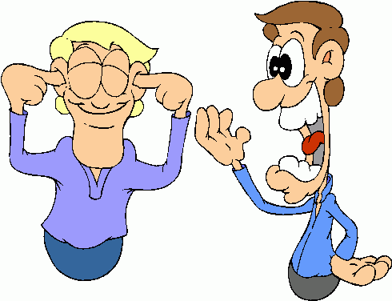
Gossip can feed rumors that contribute to a distrustful and conflict-ridden workplace. Your actions can help stop malicious gossip. Speak up and let coworkers know of your discomfort with the conversation.
Understand your “triggers and hot buttons.” Knowing what makes you angry and frustrated enables you to manage your reactions and respond in a more appropriate manner.

Slide 18
Learn to build on what you know.
Adopt a positive and solution-driven approach.

Slide 19
How would you like to get along better with your Colleagues at work?
Sometimes getting along with others can be challenging but in the workplace it is a necessary skill that will help you be successful.
By building the following skills, you will get along well with others:
Build other’s self-esteem
Show empathy for others
Encourage people to cooperate with each other.
Communicate assertively.
Ask productive questions and demonstrate listening skills.
Respond productively to emotional statements.
Handle conflicts with diplomacy.

Slide 20
How Do I Do That?
Build others’ self-esteem. When you are in a situation in which your self-esteem is built up, you feel good. You can build up the self-esteem of others by doing the following?
Make eye contact with others.
Call others by their name.
Ask others for their opinions.
Compliment the work of others.
Tell people how much you appreciate them.
Write “thank-you” notes when someone does something worthwhile.
Make people feel welcome when they come to your workplace.
Introduce coworkers to people they may not know.

Slide 21
Pay attention to what is going on in people’s lives. Acknowledge milestones and express concern about difficult life situations such as illness, deaths, and accidents.
Encourage your colleagues to explore their talents and interests.
Share people’s excitement when they accomplish things.
Honor people’s needs and wants, when appropriate.
Take responsibility for your choices and actions and expect others to do the same.
Take responsibility for the quality of your communication and working relationship.

Slide 22
Show empathy for others. Empathy means recognizing emotions in others. It is the capacity to put you in another person’s shoes and understand how they view their reality and how they feel about things.
Encourage people to cooperate with each other.
If you are managing a work group, there are some specific things you can do to create an environment in which others work well together.
Don’t assume everyone is with you.
Make sure people have clear instructions for tasks to be completed. Ask people to describe what they plan to do.
Reinforce cooperative behavior. Don’t’ take it for granted. Don’t play favorites. Treat everyone the same; otherwise, some people will not trust you.

Slide 23
Don’t talk about people behind their backs.
Ask for others’ idea. Participation increases commitment.
Follow up on suggestions, requests (even if you are unable to carry them out), and comments.
Check for understanding when you make a statement of announcement.
Communicate assertively. Assertive communication is a constructive way of expressing feeling and opinions. People are not born assertive; their behavior is a combination of learned skills. Assertive Behavior enables you to:
Act in your own best interests.
Stand up for yourself without becoming anxious.
Express your honest feelings.
Clarify wants/needs/expectations

Slide 24
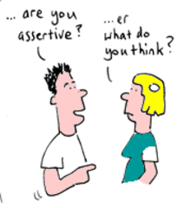
Assert your personal rights without denying the rights of others.
Focus on the behavior not the personality.
Use “I” statements.
Try to speak directly with the individual involved.
Use a problem-solving approach.
Try to reach a mutual understanding and agreement of what may change.
Assertive behavior includes both what you say and how you say it.

Slide 25
Ask productive questions and demonstrate listening skills. Listening skills help show that you are hearing and understanding another person and interested in what s/he has to say.
Choose words wisely. We must choose our words carefully so as not to offend or dismiss people. It shows we care about how we communicate.
Avoid the use of slang. Stick to the basics of the English language. Watch your tone. Tone is one of he most important factors in successful verbal communication. The wrong tone can completely throw off the meaning you are trying to communicate. An angry tone can turn

Slide 26
“have a nice day” into an insult and that is the opposite of what we want to do. Always keep an upbeat and joyful tone. If a coworker is unhappy and irate, keeping a calm soothing tone will help them deescalate.
Speak steady and project. No mumbling. Project your words clearly. Make sure to speak so people can hear what you are saying.

Slide 27
Active Listening
A communication skill called “active listening” is especially useful in emotional situations because it enables you to demonstrate that you understand what the person is saying and how s/he is feeling about it.
Active listening means restating, in your own words, what the other person has said. It’s a check on whether your understanding is correct.
It encompasses body language, encouraging words and inviting, open ended questions, restating what was said and checking out mutual understanding of the issue.

Slide 28
ACTIVE LISTENING RESPONSES HAVE THE FOLLOWING COMPONENTS:
Naming the feeling that the other person is conveying.
Stating the reason for the feeling.
Examples:
You seem annoyed by lateness.
Sounds like you’re upset about what happened at work.
You sound really stumped about how to solve this problem.
It makes you angry when you find errors on Joe’s paperwork.
Sounds like you’re really worried about Ann.
I get the feeling you’re awfully busy right now.

Slide 29
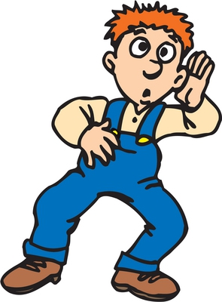
Active listening is not the same as agreement. Rather, it is a way of demonstrating that you intend to hear and understand another’s point of view.

Slide 30
Have Good Workplace Boundaries
Boundaries help us communicate clearly. All personal information should be kept confidential. Do not discuss coworkers with other and do not participate or feed into office gossip.
The keys to successful workplace relationships and communication will help you unlock the door to successful communication not only at work, but also in all of your relationships.
There are two types of people – those who come into a room and say, “Well, here I am” and those who come in and say, “Ah, there you are.

Slide 31
The ability to get along well with people in your workplace comprises a set of learned skills. No one is born knowing how to build others’ self-esteem, show empathy, encourage cooperation, communicate assertively, ask productive questions, or respond productively to emotional statements. These skills can be learned and developed with some practice. By taking the time to develop these skills, you will be able to build better relationships at work, feel good about your role and feel successful in your job.

Slide 32
Don’t limit your challenges.
Challenge your limits.
Keep growing your skill set.
--Unknown
This Photo by Unknown Author is licensed under CC BY-NC-ND

