Slide 1
COMPASSION FATIGUE
THE STRESS OF CARING TOO MUCH

Slide 2
C Figley, 1995
“We have not been directly exposed to the trauma scene, but we hear the story told with such intensity, or we hear similar stories so often, or we have the gift and curse of extreme empathy and we suffer. We feel the feelings of our clients. We experience their fears. We dream their dream. Eventually, we lose a certain spark of optimism, humor and hope. We tire. We aren’t sick, but we aren’t ourselves.

Slide 3
Compassion Fatigue was recognized by Carla Joinson in 1992.
She discovered how working daily with individuals in caregiving ways affected the worker. The length of being a worker in this role can be characterized by symptoms of “anxiety, sleep disturbance, depression, cynicism, anger and irritability.” Inefficiency and lower tolerance for frustration are common, as is difficulty separating from work and personal life. This is “compassion fatigue” and is associated with the “cost of caring” for others in emotional and physical pain. Compassion fatigue is coping with secondary traumatic stress in those who treat the trauma or critical situation.

Slide 4
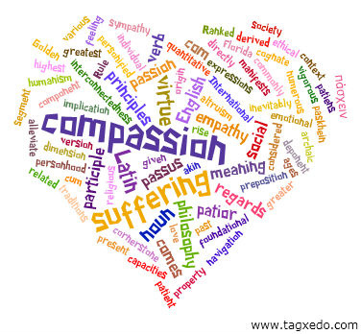
Who Does It Affect?
Who is vulnerable to Compassion Fatigue, in what type of work setting, under what types of conditions and once developed, how can it be treated and return the worker back to good morale and psychological safety.

Slide 5
The WHO
Anyone care giving on a regular basis
Medical and emergency employees.
Mental health and substance abuse employees.
Social and educational workers.
Police and security personnel.
First responders.
Corrections and welfare employees.
All employees who work in a trauma setting and helping victims dealing with the emotional burdens.
Working directly with people, being directly involved in other people’s lives and people who have needs, which you are trying to help get their needs met.

Slide 6
These employees have the difficult task of showing compassion to those who suffer but not becoming too personally involved in their lives. The need to be empathetic and have good boundaries is important in the helping role. Burnout is a real and recognized risk in these stressful professions. As a result these talented people are exposed to compassion fatigue.
Everyone feels stress; life is stressful, given work, family and other daily demands. While some jobs are more stressful than others, working directly with people means becoming directly involved in other people’s lives and in the lives of people in need. It means emphasizing your clients need at the possible risk of minimizing, deferring or even ignoring your own needs.

Slide 7
How does “Compassion Fatigue” affect individuals?
Compassion Fatigue happens when emotional residue, whether from work and/or life, compromises the personal well-being, perhaps due to being in one-way relationship for so long.

Slide 8
As Pfiferling and Gilley wrote in April, 2000, Family Practice Management Journal:
“Those who have experienced compassion fatigue describe it as being sucked into a vortex that pulls them slowly downward.”
They have no idea how to stop the downward spiral, so they do what they’ve always done; work harder and continue to give to others until they’re completely tapped out.

Slide 9
Recognizing Compassion Fatigue Symptoms
These symptoms are normal displays of stress resulting from the care giving work you perform on a regular basis.
Bottled up emotions
Excessive blaming
Isolation from others
Receives unusual amount of complaints from others
Voices excessive complaints about administrative functions
Substance abuse to mask feelings
Compulsive behaviors such as overspending, overeating, gambling, sexual addictions
Poor self-care (hygiene, appearance)
Indebtedness, legal problems
Reoccurrence of nightmares/flashbacks

Slide 10
Chronic physical ailments such as gastrointestinal problems and recurrent colds
Apathy, sad, no longer finds activities pleasurable
Difficulty concentrating
Mentally and physically tired
Preoccupied
In denial about problems
Loss of hope and self-worth
Depression, anxiety, PTSD
High absenteeism
Changes in relationships with coworkers, aggressive behavior
Inability to work collaboratively with your team, lacking respect for colleagues.
Desire to break company rules, negativism toward management
Incomplete assignments/tasks, don’t meet deadlines

Slide 11
Lack of flexibility with staff members
Strong reluctance toward change
Inability to believe there could be improvement
Lack of vision for the future.

Slide 12
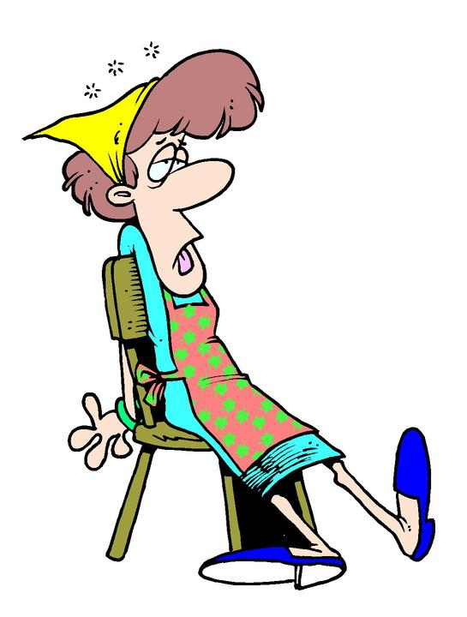
AWARENESS
Think of events or situations that cause one to experience an unusually strong reaction and often overpowers one’s usual coping mechanism.
Are you aware of any of these issues or contributing factors in your workday? If so, you could be at risk for
“compassion fatigue”

Slide 13
Ability to function is interfered with or altered.
Situation or incident does not seem “typical or ordinary”, it feels traumatic.
“Compassion stress” impinges upon or breaks through normal boundaries.
Regularly waking up tired in the morning and struggling to get to work.
Feeling as if you are working harder but accomplishing less?
Becoming frustrated/irritated easily?
Losing compassion for some people while becoming over involved in others?

Slide 14
Routinely feeling bored or disgusted?
Experiencing illness, aches and pains?
The consequences of untreated cumulative stress can result in absenteeism, sleep disorder, burn out, emotional difficulties, relationship problems, health problems, personality changes, increase alcohol or drug use and other complications. ( Refer to examples of Compassion Fatigue Burnout symptoms.)
Long-term effects of ineffective stress management can result in post-traumatic stress disorder. Burnout is more advanced, more serious state when the affected employee can no longer cope with their environment.
The person “shuts down” from complete physical, mental and emotional exhaustion.

Slide 15
What can we do to support the employee and individual?
What is critical in preventing and treating “Compassion Fatigue.”
What can we do to debrief the ongoing cumulative stress?
Accept that such a risk is out there.
Recognize the importance of self-care to do something about it.
Implement a simple but useful defusing process, every one to three weeks, depending on the need.
(All members of that work group are invited and participate voluntarily. The focus is on personal well-being along with work place issues.)

Slide 16
Set Emotional Boundaries
It is important to set firm emotional boundaries to protect yourself. Empathy and compassion are at the forefront of working with people in many careers.
The challenge is to remain compassionate, empathetic and supportive of others without becoming overly involved and taking on another’s pain.
Setting emotional boundaries help maintain a connection while still remembering and honoring the fact that you are a separate person with your own needs.

Slide 17
Authentic and Sustainable Self-Care Begins with YOU
Once you realize that you are a candidate for compassion fatigue or are suffering its effects, exploring this new awareness can lead to insights concerning past traumas, pain, and defeating behaviors. Most people never take the time to understand how their jobs affect them emotionally. Give yourself credit for moving forward and affecting change. Healing the symptoms of compassion fatigue
Is an inside job.

Slide 18
So:
Be kind to yourself.
Create a daily routine to help have a sense of control
Enhance your awareness with education.
Accept where you are on your path at all times.
Understand that those close to you may not be there when you need them most.

Slide 19
Exchange information and feelings with people who can validate you.
Listen to others who are suffering.
Clarify your personal boundaries. What works for you; what doesn’t.
Express your needs verbally.
Take positive action to change your environment.
Health building activities – such as exercise, massage, yoga, meditation.

Slide 20
Eating healthy foods and drinking plenty of water.
Use natural healing products to care for and heal your body.
Practicing the art of self-management. Learn to say NO.
Develop a healthy support system; people who contribute to your self-esteem, people who listen well, people who care.
Organizing your life so you become proactive as opposed to reactive.

Slide 21
Reserving your life energy for worthy causes. Choose your battles.
Living a balanced life; sing, dance and sit with silence.
Seek mental health assistance when you are concerned about your reactions or thoughts.

Slide 22
Boost Your Resiliency
Resilience is our ability to bounce back from stress.
While some people seem to naturally be more resilient than others, resilience is a skill that can be learned and cultivated. Resilience can be thought of as the ability to adapt to and become stronger through adversity.

Slide 23
REMEMBER
Some behavior changes following a crisis or intense intervention is a typical response to an extraordinary situation.
Behavior changes following a crisis or intense intervention are generally temporary.
Each person responds in a different way and moves through the experience at his/her own pace.
You are not alone!
It is a sign of strength, not weakness to ask for help when it is needed.

